Slide 1
Thesis writing guidelines
Dr. Arif Mahmud
Associate Professor & Associate Head
Department of CSE, Daffodil International University

Slide 2
Results vs. discussion vs. conclusion
In the results section, the data are presented simply and objectively. No speculation or interpretation is given.
In the discussion section, the meaning of the results is interpreted and put into context (e.g., compared with other findings in the literature), and its importance is assigned.
In the conclusion section, the results and the main conclusion are summarized and ensure that objectives are fulfilled.

Slide 3
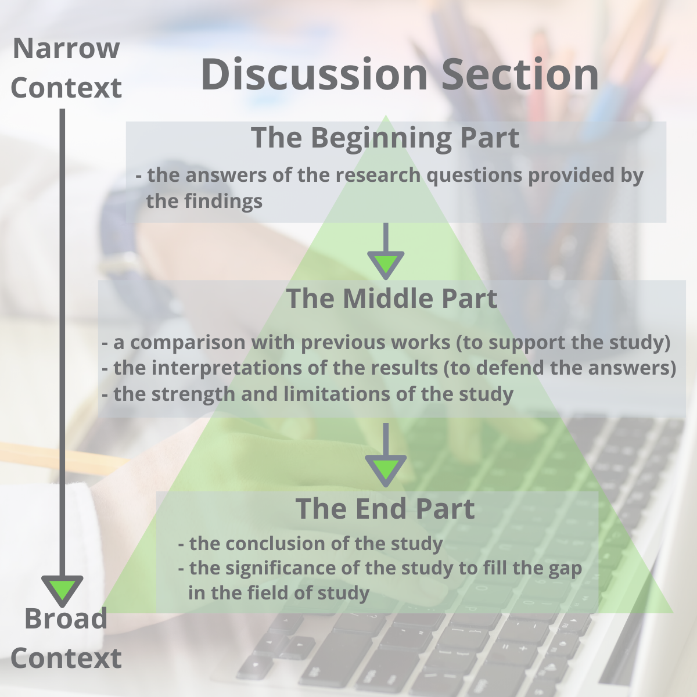
discussion

Slide 4
Discussion in brief
Summary: A brief recap of your key results
Interpretations: What do your results mean?
Implications: Why do your results matter?
Limitations: What can’t your results tell us?
Recommendations: Avenues for further studies or analyses

Slide 5
Steps
Step 1: Restate your research problem and research questions
Step 2: Summarize your key findings
The data suggest that…
The data support/oppose the theory that…
The analysis identifies…
Step 3: Interpret your results
How do your results relate with those of previous studies?
If you get results that differ from those of previous studies, why may this be the case?
What do your results contribute to your field of research?
What other explanations could there be for your findings?

Slide 6
Steps
Step 4: Acknowledge the limitations of your study
Step 5: Make recommendations for implementation and future research
Step 6:Deliberate the implications
1) Do your findings support or refute the extant research? What new contributions do they add to the existing knowledge?
2) Are there any substantial differences between your results and those of other studies? Suppose they are. What would be the reason?
3) Do your findings uphold or refute the extant theories?
4) What would you say about the practical implications of your results?
Step 7: Provide a concluding summary: confirm that this section flows well from and has a strong connection to the opening section of the chapter.

Slide 7
To avoid
Don’t introduce new results: You should only discuss the data that you have already reported in your results section.
Don’t make inflated claims: Avoid over interpretation and speculation that isn’t directly supported by your data.
Don’t undermine your research: The discussion of limitations should aim to strengthen your credibility, not emphasize weaknesses or failures.
Tables and figures (these are usually included in the results section)

Slide 8
Further Resources
Creswell, J. W. (2014). Research Design: Qualitative, Quantitative and Mixed Methods Approaches (4th ed.). Thousand Oaks, California: Sage.
Kothari, C.R. (2004). Research Methodology: Methods and Techniques (2nd ed.). Delhi: New Age International Publishers.
Bryman, A., & Bell, E. (2007). Business research methods (2nd ed.). New York: Oxford University Press.
Sekaran, U. (2003). Research methods for business: A skill-building approach (4th ed.). New York: John Wiley & Sons.

Slide 9

The End
Thank You

